Slide 1
Task: Prediction of Graduate Admissions

Slide 2
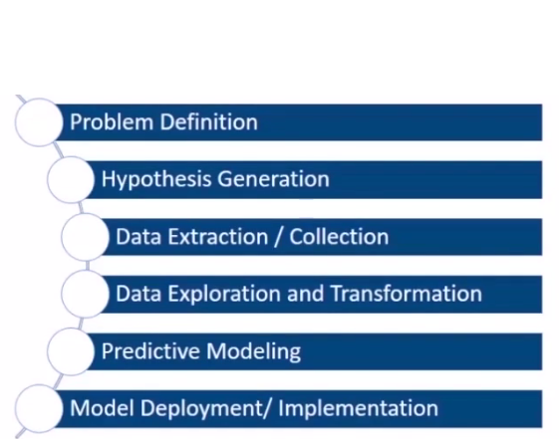
we can broadly divide the machine learning lif cycle in 6-stages

Slide 3
Problem and data discription:
This dataset was built with the purpose of helping students in shortlisting universities with their profiles. The predicted output gives them a fair idea about their chances for a particular university.
The parameters included are :
GRE Scores ( out of 340 )
TOEFL Scores ( out of 120 )
University Rating ( out of 5 )
Statement of Purpose and Letter of Recommendation Strength ( out of 5 )
Undergraduate GPA ( out of 10 )
Research Experience ( either 0 or 1 )
Chance of Admit ( ranging from 0 to 1 )

Slide 4
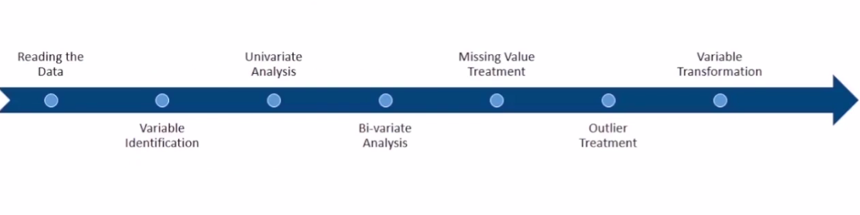
Data Exploration/transformation flow:

Slide 5
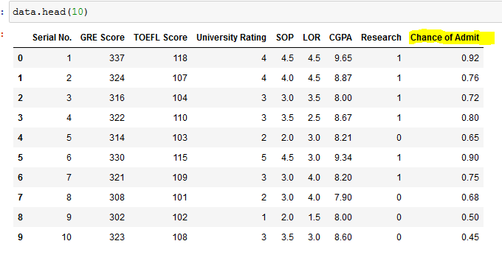
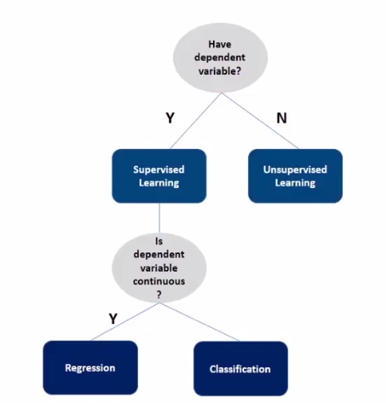
@ dataset has 500 students information describe in 7-parameters

Slide 6
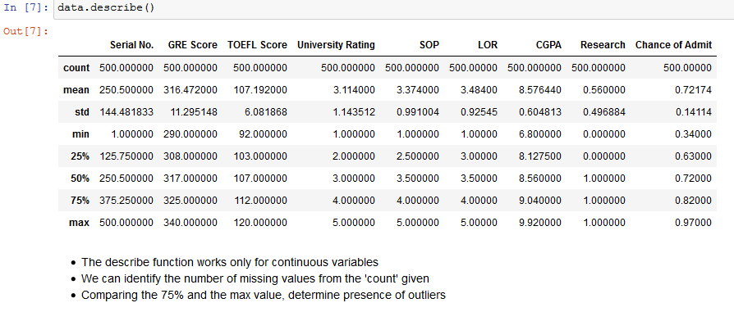

Slide 7
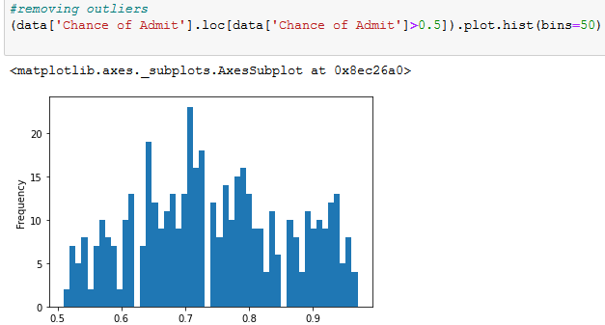
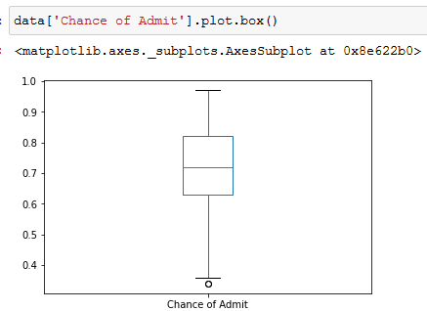
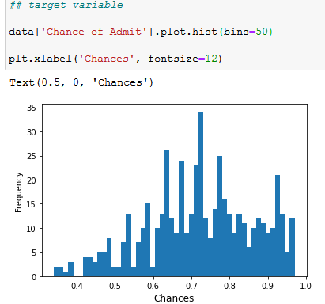
No missing values so our work became so easier, just removing the outliers

Slide 8
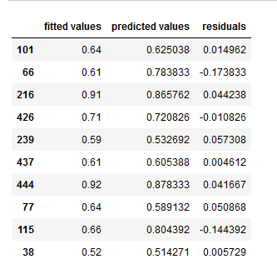
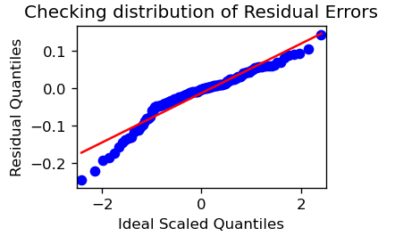
Building the Model- Linear Regression
'

Slide 9
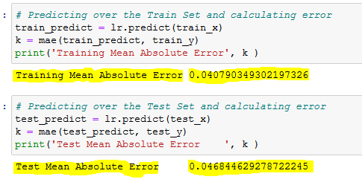
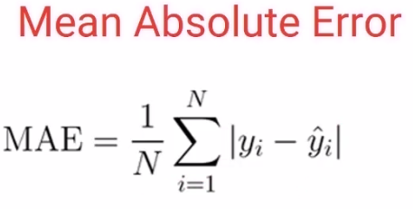
Evalution:

Slide 10
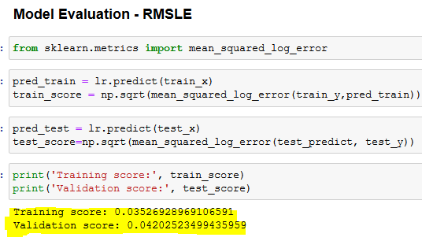
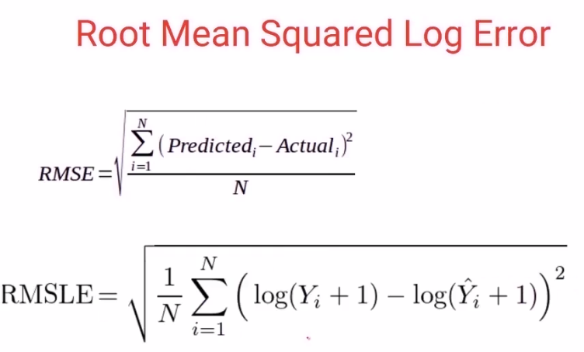

Slide 11
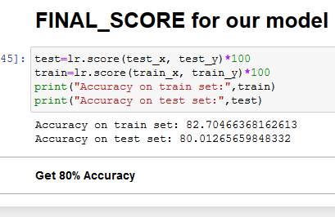
Accuracy of Model:

Slide 12
Thank You sir ..
Kranthi kumar M

